Slide 1

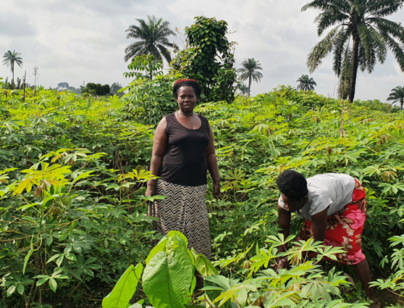


Climate Smart Farming and Resilience Building for African Women Farmers
Chinwoke Clara Ifeanyi-obi, PhD
Department of Agricultural Extension and Development Studies,
University of Port Harcourt, Rivers State, Nigeria
Project Lead, Gender-Responsive Climate Change Adaptation Initiative in Nigerian Agriculture (GCAINA)
AWARD Fellow, Gender Responsive Agricultural Systems Policy (GRASP)
Presented at the A14WIA Project conference held at the KWASU International Conference Centre, 24th October 2023

Slide 2
Presentation Outline
Overview of climate change
What does climate change hold for African agriculture?
Climate Smart Agriculture
Why gender in CSA?
Challenges of uptake of CSA among women farmers
Conclusion & Recommendations

Slide 3
Overview of climate change in Africa
Climate change is simply significant variations in the mean state of climate lasting for an extended period of time say a decade or more;
Climate change according to Intergovernmental Panel on Climate Change (IPCC) refers to a change in the mean state of the climate variables whether due to natural variability or as a result of human activities which has persisted for an extended period, typically decade or longer.

Slide 4
Cont’d
When the climate variables (like rainfall, atmospheric temperature, drought, solar radiation etc.) are no longer predictable, for a long period of time say ten years, we call it climate change.
Example, for over ten years, rainfall no longer starts at the usual onset of rainy season. It either starts very late or starts and ceases for a long period of time within the rainy season (long period of drought within the rainy season) or comes very late (heavy rains coming in the dry season).

Slide 5
What causes climate change?
Climate change is caused by all activities that contribute to emission of Greenhouse gases [particularly Carbon dioxide (CO₂), Methane, nitrous oxide etc.] into the atmosphere are the drivers of climate change through global warming.
Two major causes of climate change are:
Human activities (major casual factor): All activities by human beings that stimulate emissions or reduce absorption of greenhouse gases contribute to climate change. Examples include: Cutting down trees (deforestation reducing carbon sink), bush burning, energy consumption, burning of fossil fuels
Natural causes (minimal causal factor) induced by natural cyclic events, example forest fires, Volcanos, Savanna fires

Slide 6
Generally, the earth is facing many extreme pressures ranging from population growth pushing for increased food, deforestation and greater greenhouse gas emissions to industrial and technological growth pushing for more power consumption than ever
Carbon dioxide concentration in the atmosphere has risen from hovering around 275ppm in pre-Industrial time, to 413ppm as of early 2020
There is urgent need to return to a ‘safe’ concentration of 350 ppm by 2100 in order to stabilize global warming
The earth is already about 1.1°C warmer than it was in the late 1800s, and emissions continue to rise. To keep global warming to no more than 1.5°C – as called for in the Paris Agreement – emissions need to be reduced by 45% by 2030 and reach net zero by 2050.

Slide 7
What does climate change hold for African Agriculture?
It is important to note that Agriculture is by far the single most important economic activity in Africa. It provides employment for about two-thirds of the continent’s working population and for some countries in African, contributes an average of 30 to 60 percent of gross domestic product and about 30 percent of the value of exports.

Slide 8
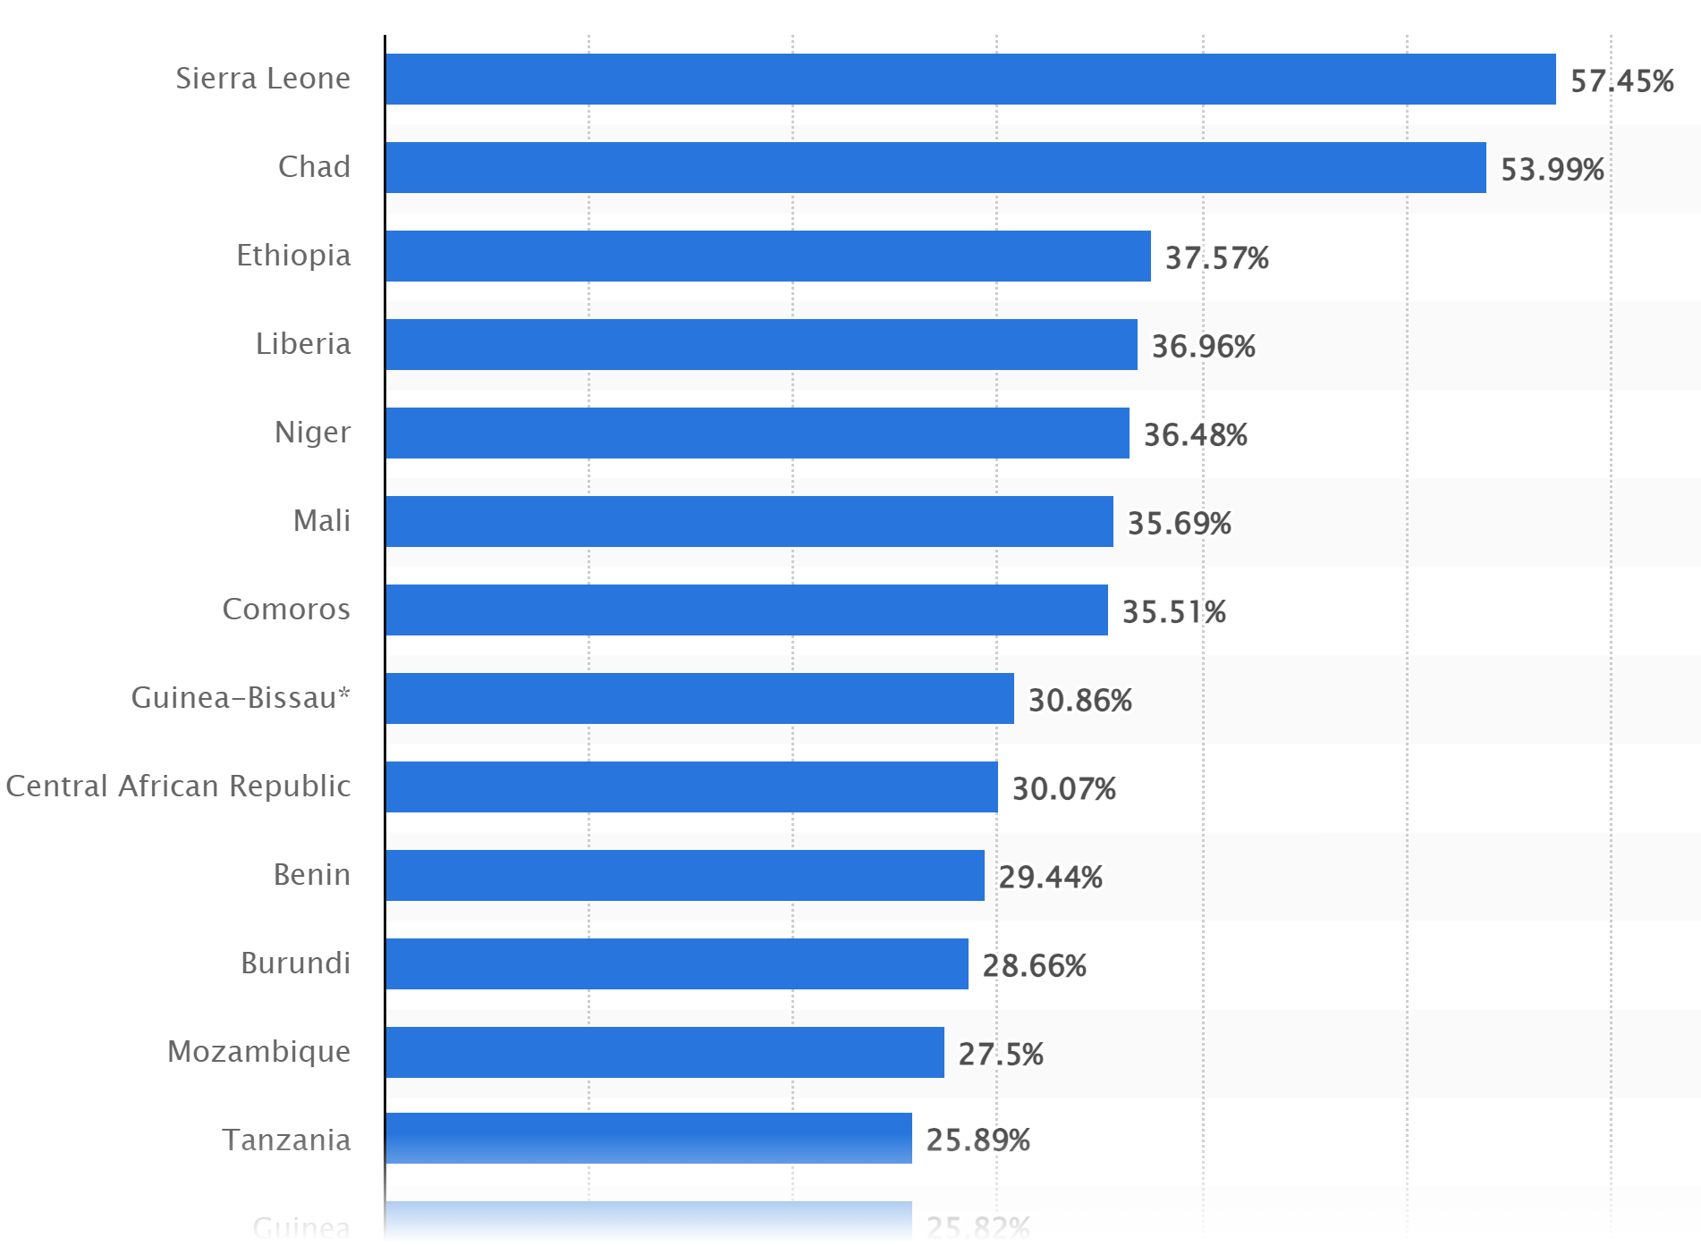
Contribution of agriculture, forestry, and fishing sector to the Gross Domestic Product (GDP) in Africa as of 2021, by country
Source: Statista, 2023

Slide 9
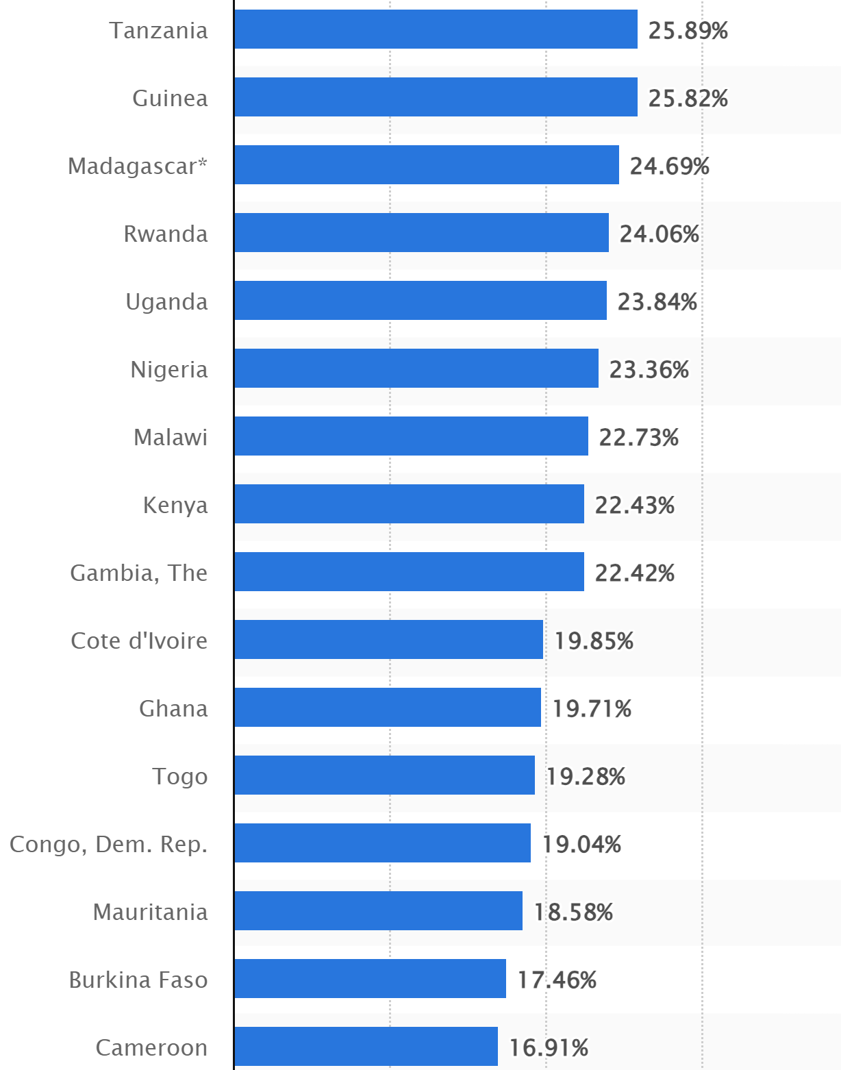
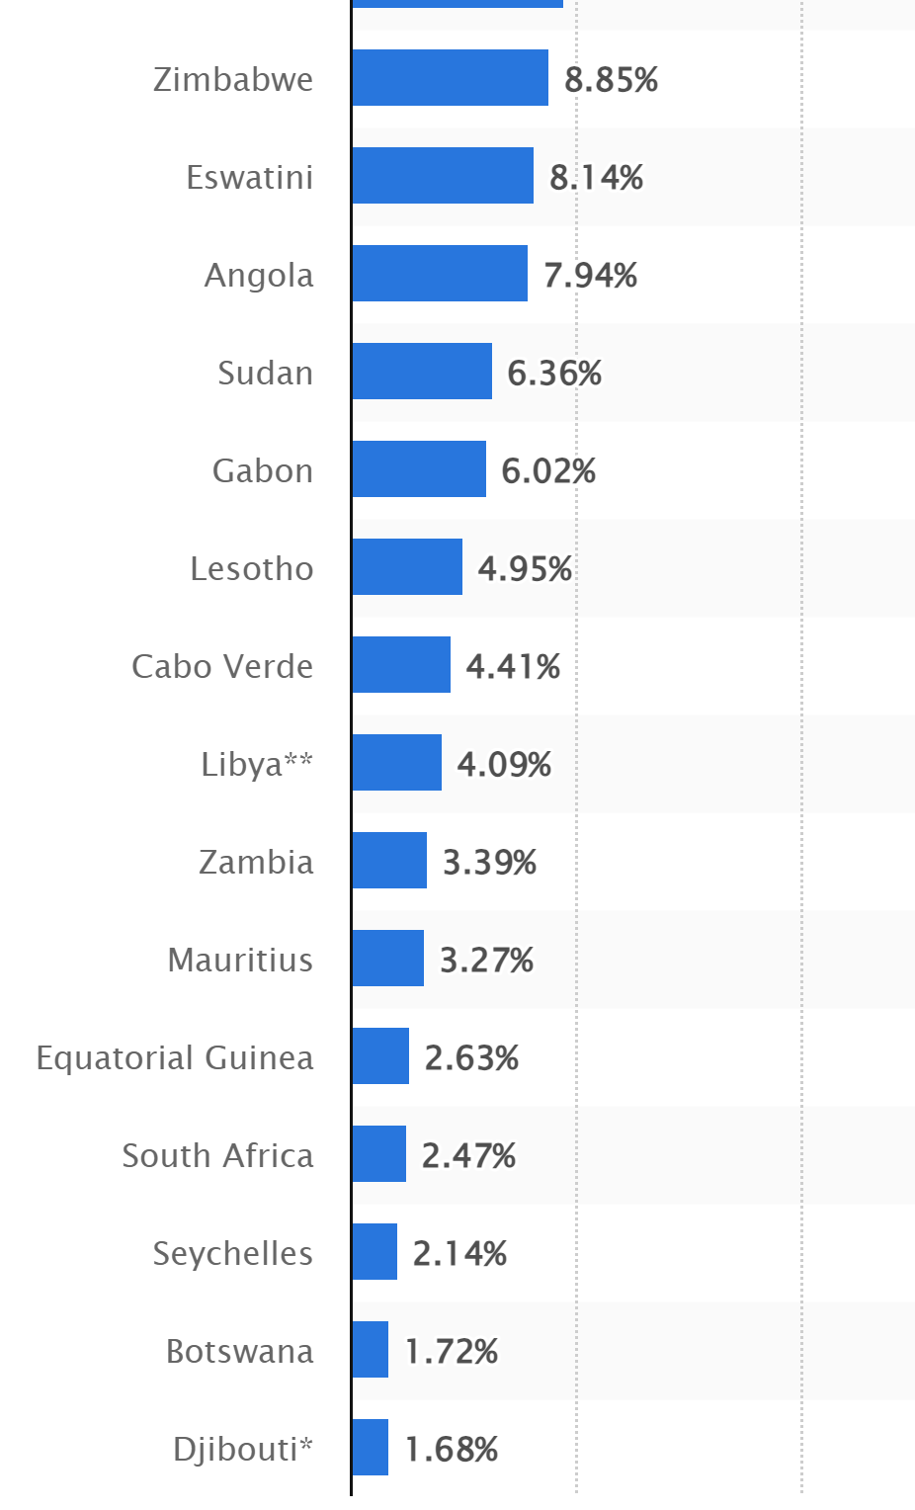

Slide 10
What does climate change hold for African agriculture Contd’?
Though climate change affects all sectors of the economy, the worst hit is the agricultural sector particularly, African agriculture
FAO (2009) noted that Africa will be the most vulnerable to climate change globally, due to the multiple stresses of poor infrastructure, poverty and governance (Has the story changed?)

Slide 11
Some early key projections (IPCC, 2007), showcasing the risks and threats of climate change to African agriculture:
- Temperatures are likely to increase by between 1.5-4ºc
- Crop yield projected to drop by up to 50% and crop revenue is forecast to fall by as much as 90% by 2100.
- Increase periods of prolonged droughts and /or floods likely to happen
- Agriculture losses of between 2-7% of GDP is expected by 2100 in parts of the Sahara, 2-4% & 0.4-1.3% in Western and Central Africa and Northern and Southern Africa respectively.
- Arid and semi arid land could expand in coverage by 60-80M ha.
- Fisheries will be particularly affected due to changes in sea temperatures that could decrease trends in productivity by 50-60%.
- Productivity in Africa will be further undermined by a reduction in fertile agricultural land available and an expansion in the coverage of low potential land.

Slide 12
Then, World Bank (2009) forecast shows that:
- SSA will surpass Asia as the most food insecure region inhabiting 40-50% of undernourished people globally in 2080. Levels of viable arable land for production are predicted to decline by 2080, with 9-20% of arable land becoming much less suitable for agriculture.
- In response to variations in temperature and precipitation, an increase in crop pests and diseases in addition to altered soil fertility is expected to happen.
- Declining incomes and rising unemployment are expected to hit agriculture zones in combination to worsening health.
- A fall in nutrient access is likely to raise susceptibility to diseases such as malaria and HIV/AIDS.

Slide 13
Conversely, it is important to note that not all assessments of the impact of climate change in Africa are negative
For instance, Ethiopia and Southern Africa are expected to have extended growing seasons due to climate change, a consequence of increased temperature and rainfall changes.
Also, the livestock sector could be boosted by temperature increases, according to IPCC models, an increase in 5ºc could mean a rise in farmer incomes by up to 58%.

Slide 14
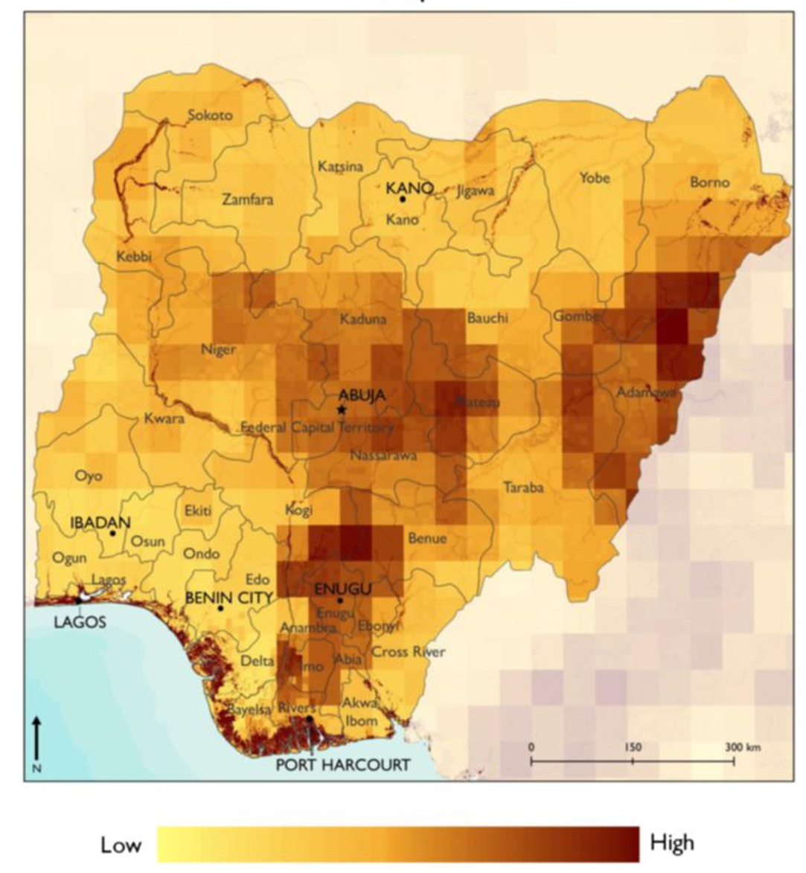
Nigerian Situation
Nigeria is recognized as vulnerable to climate change impacts, ranked 160 out of 181 countries in the 2020 ND-GAIN Index.
Extreme weather events will continue to worsen while the agricultural sector remains the most impacted (NIMET, 2021)
372 out of the country’s 744 LGAs are at risk of flooding (UN, 2023)
In only 2022, 662 were killed by flooding, 3174 injured, 2.5M displaced and 200,000 houses destroyed
Source: USAID Country Brief, Nigeria

Slide 15
Nigeria is a developing economy with a projected population of 206.14 (2020) people growing at 2.5%
Nigeria’s population is projected to reach 262.9 and 401.3 million people in 2030 and 2050, respectively
Current projections shows that Nigeria needs urgent action to reduce the increasing impacts of climate change
Source: Climate Risks Profile of Nigeria
Mean temperature rise of between 1.8 and 3.9 °C is projected until 2080
Sea level to rise between 31 cm (RCP2.6) and 39 cm (RCP6.0) until 2080
Crop yields to reduce by 30% by 2030
Water availability to decline by more than 75 % – from 3 300 m³ per capita and year in 2000 to about 800 m³ per capita in 2080 – and thus fall below the UN threshold for water scarcity.
Source: Climate Risks Profile of Nigeria

Slide 16
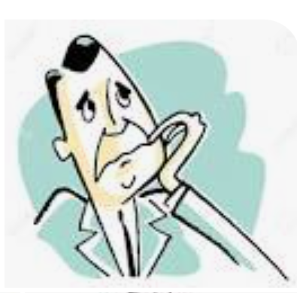
Unfortunately, help comes from nowhere, the world is also facing food crisis
Nearly 690 million people (8.9% of the global population) are hungry, up by nearly 60 million in five years (FAO, 2020)
The food security challenge will only become more difficult, as the world will need to produce about 70 percent more food by 2050 to feed an estimated 9 billion people.
1/3 of food produced globally is either lost or wasted (World bank, 2020)
The world is not on track to achieve Zero Hunger by 2030. If recent trends continue, the number of people affected by hunger would surpass 840 million by 2030.
We need to fix food security issues in our continent

Slide 17
While we examine the adverse effects of climate change on the agricultural sector, it is important to that agricultural activities also contribute to climate change
World bank (2021) stated that agriculture currently generates 19–29% of total Greenhouse Gas (GHG) emissions)_This will rise if no action is taken
Hence, the cogent need for a farming system that does not only emphasize increased productivity and resilience building but tackles emissions can not be over emphasized

Slide 18
Climate Smart Agriculture(CSA)
Climate-smart agriculture (CSA) is an integrated approach to agriculture that addresses the interlinked challenges of food security and accelerating climate change.
CSA aims to simultaneously achieve three outcomes:
- Increased productivity: Produce more and better food to improve nutrition security and boost incomes
- Enhanced resilience: Reduce vulnerability to extreme weather risks & shocks and improve capacity to adapt and grow in the face of changing weather patterns
- Reduced emissions: Pursue lower emissions for each calorie or kilo of food produced

Slide 19
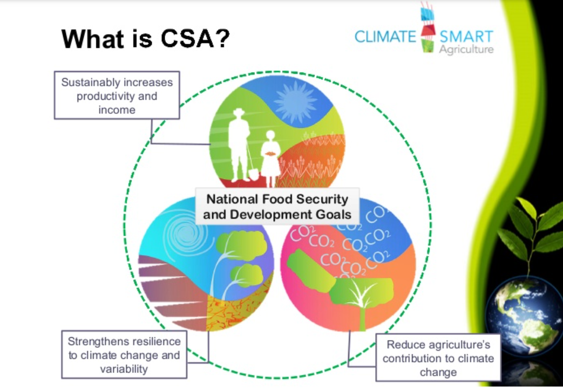
Source: Papuso & Faraby, (2013)

Slide 20
Though CSA is built on existing knowledge, technologies, and principles of sustainable agriculture, CSA is distinct in several ways:
CSA explicitly focus on addressing climate change: Contrary to conventional agricultural development, CSA systematically integrates climate change into the planning and development of sustainable agricultural systems
CSA systematically considers synergies and manages trade-offs: Ideally, CSA produces triple-win outcomes: increased productivity, enhanced resilience and reduced emissions.
It aims to capture new funding opportunities to close the deficit in investment.

Slide 21
CSA is context and location specific
It has multiple entry points at different levels
It engages women and marginalised groups
CSA strives to involve all local, regional and national stakeholders in decision-making.
Finally, CSA maintains ecosystems services. CSA interventions do not contribute to their degradation rather it adopts an approach that builds upon the principles of sustainable agriculture

Slide 22
Climate Smart Farming practices
Soil management _ Minimum tillage, integrated soil fertility management, legume integration, planting cover crops, increased fallowing, increased mulching, use of organic and inorganic manure
Water management _Traditional water conservation methods, rain water harvesting, tied ridges
Chemical input management _use of pesticides & Herbicides,
Crop Management _ Intercropping, pest and disease mgt, use of improved varieties, crop diversification, crop rotation, cover cropping, planting shade trees, weed management, adjustment in farming calendar
Planting trees/agroforestry _ Planting of shade trees and wind breaks

Slide 23
Why gender in CSA?
Climate change is not gender neutral, men and women are impacted differently by climate change
Unfortunately, women are more exposed and vulnerable to climate change because they are often poorer, receive less education, and are not involved in political and household decision-making processes that affect their lives (UNDP, 2012).
Climate change risk and vulnerability factors are heightened by the gender-differentiated needs and roles of the society
80% of the people displaced by climate change are women (UNDP, 2019)

Slide 24
Gender inequality and the climate crisis are two of the most urgent challenges of today (UN Women, 2022)
Gender-responsive means addressing the different situations, roles, needs, and interests of women, men, girls, boys, people living with special needs etc. in the design and implementation of activities, policies, and programs.
Activities that pay attention to specific gender needs (women is of priority in this context)

Slide 25
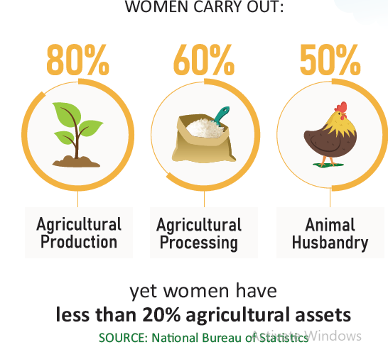

Highlights from the Agricultural sector
Women represent between 60% and 79% of Nigeria’s rural labour force, yet males are five times more likely to own land than females (FMARD, 2019; GCAINA policy brief 2, 2022).
Sustainable development cannot be achieved without tackling climate change and climate change cannot be tackled without tackling the root causes of poverty which is embedded in gender inequality
‘6 out of 10 rural work force are women but the men are 5 times more likely to own land in Nigeria’
It is therefore important to wear gender lens in initiating and implementing interventions in climate change issues in the agricultural sector

Slide 26
Key findings from GCAINA project Field survey
Type of SE suffered by RW
79% agreed social exclusion of women exists
Denial of ownership of asset like land (96%),
Unequal chances of participation in decision making (79%) and
unequal access to information & resources (78%)
Traditional beliefs and practices that heightens social exclusion
80% agreed that traditional beliefs & practices heighten SEW
Women are seen as properties to be inherited by men (X̄ = 3.64)
Weaker sex than men in strength, knowledge and capacity (X̄ = 3.51) and
Subordinates to men (X̄= 3.46).

Slide 27
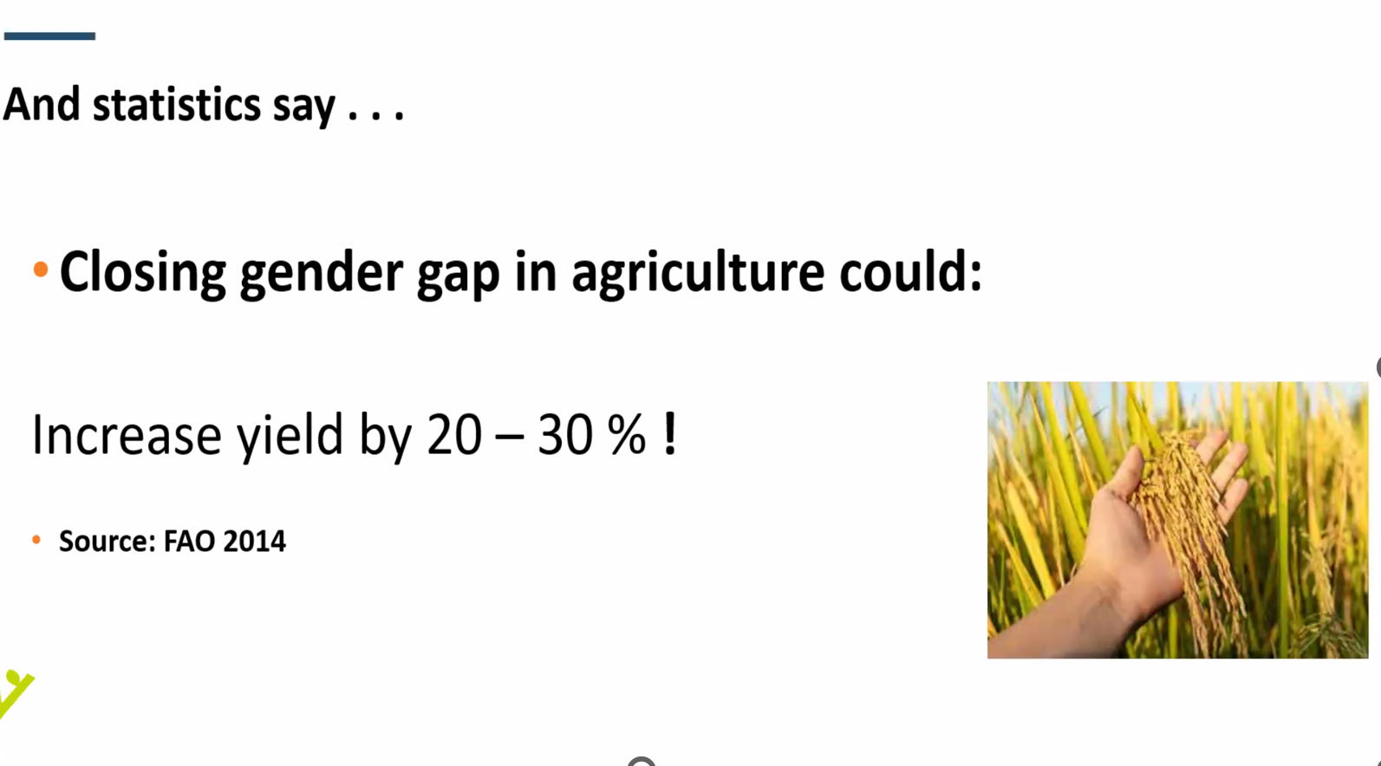

Slide 28

Effective and successful adaptation to climate change
Gender Transformation
Addresses underlying causes. Creates equitable outcomes
Gender Aware
Gender Neutral
Gender Blind
Gender Responsive
Addresses diversity needs & intervention transformation
Gender Sensitive
Addresses inequalities gives equal value to gendered needs
Gender Accommodating
Examines existing gender differences & inequalities
Gender Exploitative
Reinforces or takes advantage of gender inequitable & stereotypes

Slide 29
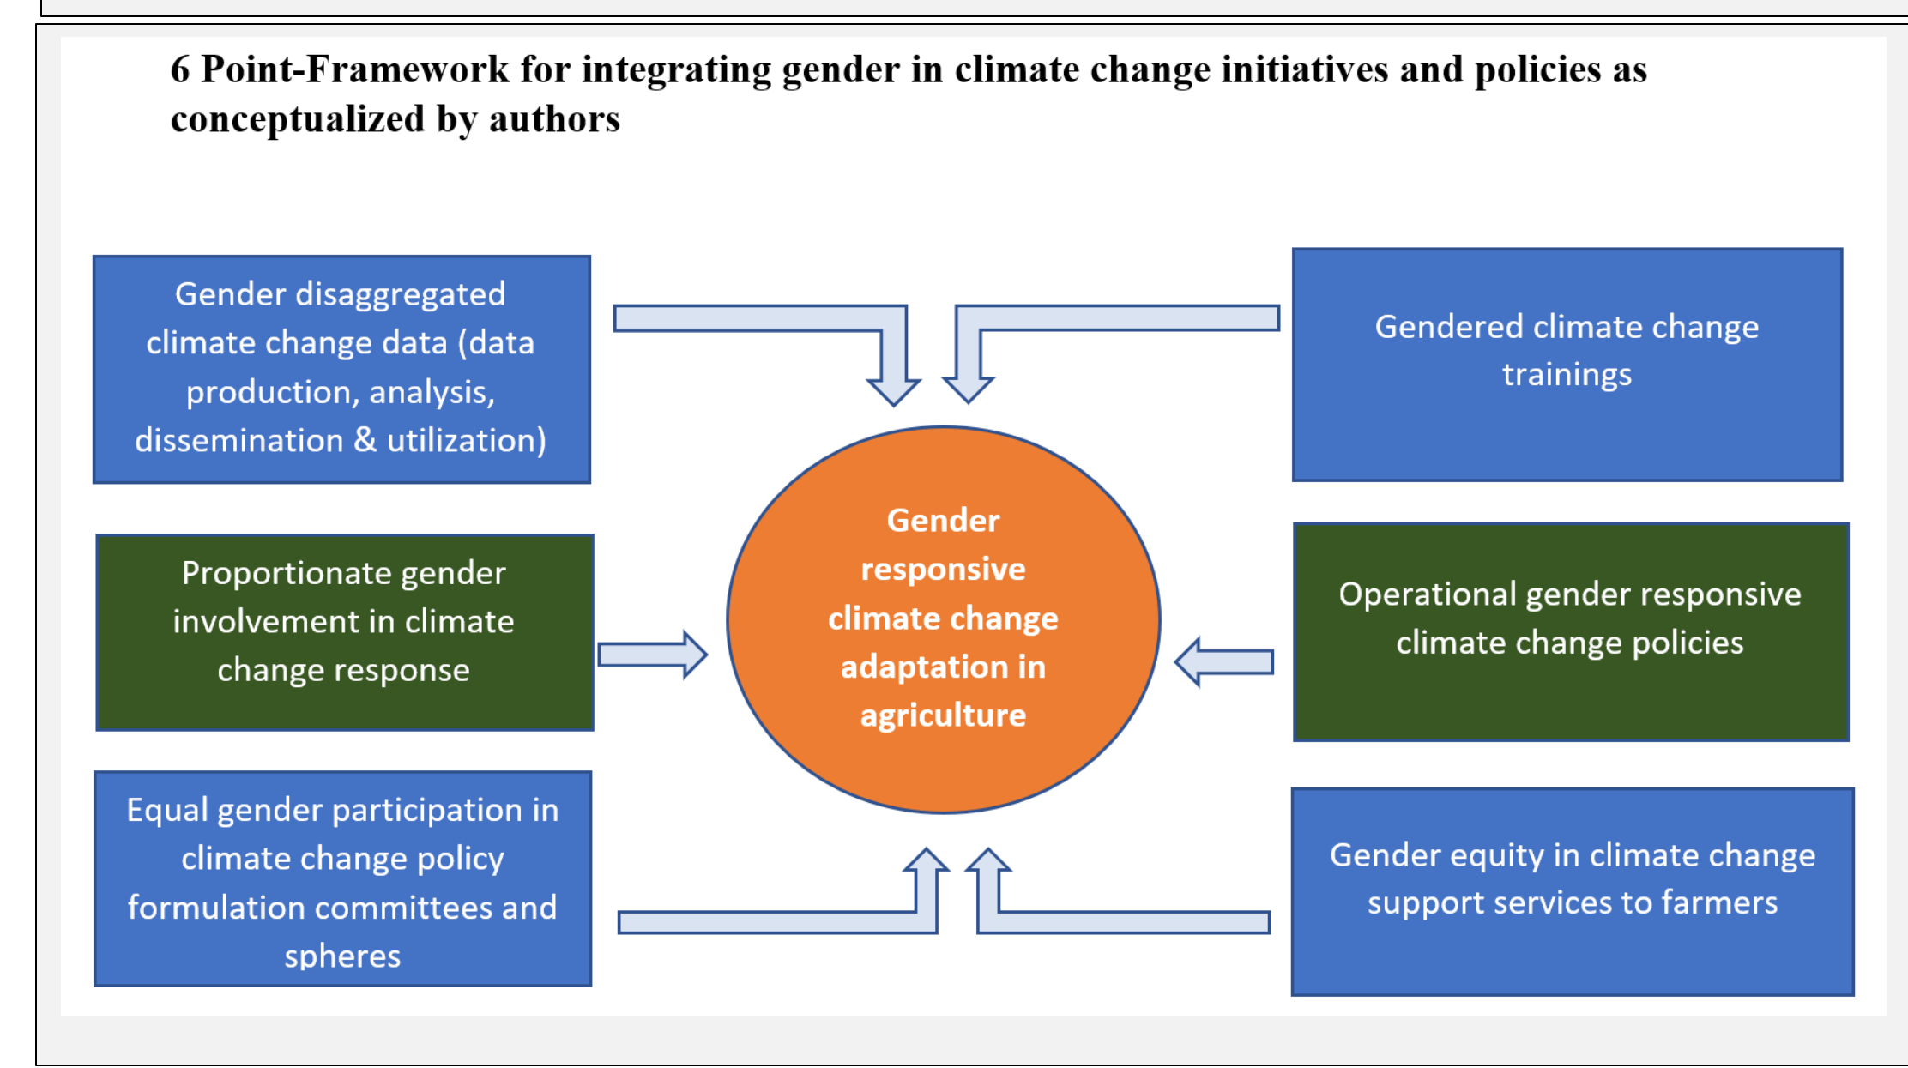
Source: Ifeanyi-obi, C.C., Aderinoye-Abdulwahab, S.A., Issa, F.O., Ayinde, F., Umeh, O., Akwiwu, U., Adesope, O.M., Obafemi, A., Adegoke, J. Oladele, I. Gender
responsive Climate Change Adaptation Initiative in Nigerian Agriculture (GCAINA) Policy Brief, No. 2. 2022

Slide 30
Low involvement and participation in climate change
Traditional beliefs and practices
Challenges to uptake of CSA among women farmers
Poor access to information and resources
Low implementation of gender commitments in existing policies
Poor knowledge, capacity & income earning power
Challenges to uptake of CSA among women farmers
Source: GCAINA Project Report

Slide 31
Conclusion
The Food and Agriculture Organization highlighted that if women farmers had equal access to productive resources, their farm yields would increase by 20 to 30 per cent. This could provide enough food to keep 100 to 150 million people from going hungry, reducing global hunger by 12 to 17 per cent.
We must transform from being climate-sensitive to climate-responsive

Slide 32
Recommendations
Operationalize and implement existing policies. Application of existing gender commitments to climate change responses
Knowledge and Capacity building must be demand and need-driven and done at frequent intervals
Women participation in climate interventions must go beyond consultation to active involvement
Structured approach for sustained access to information and needed resources among women
Increased funding for generation of gendered-disaggregated data that recognizes different categories and levels within each gender

Slide 33



Acknowledgements
(GCAINA)
The Gender-Responsive Climate Change Adaptation Initiative in Nigerian Agriculture
University of Port Harcourt

Slide 34


